Slide 1
Playwright Reliable End-to-End Testing
@Dave_Paquette
https://www.aspnetmonsters.com https://www.davepaquette.com

Slide 2


Slide 3

End-to-End Testing
Selenium
PhantomJS / CasperJS
Protractor
Cypress
Puppeteer
https://playwright.dev
Notes:
PhantonJS – QTWebKit – Super old (by browser standards) fork of WebKit. Please don’t use this!
Protractor is built on top of Selenium. NodeJS based and used to test Angular apps.
Cypress was one of the first full e2e testing libraries that managed to go break free from Selenium
Puppeteer is similar to Playwright but only NodeJS support and limited support outside of Chrome/Chromium

Slide 4

Playwright
Cross Browser - Cross Platform - Cross Language
Resilient – No Flaky tests – No Trade-offs
Powerful Tooling

Slide 5
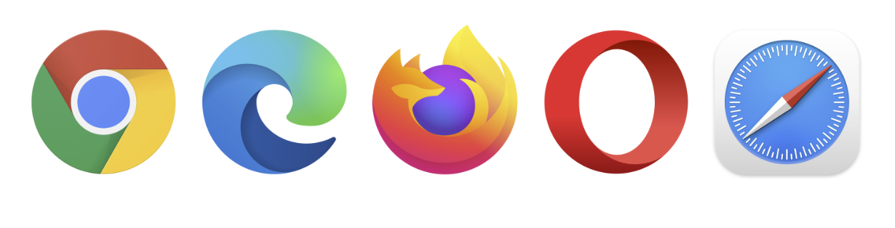








Slide 6
No Flakey Test
Auto Wait
Web First Assertions
Tracing
Notes:
One of the main reasons web tests fail is because the DOM isn’t ready for whatever action you’re performing. In the past, we’ve solved this by adding artificial waits but it never worked 100% of the time.
Playwright instead waits for elements to be actionable before performing actions and it has a rich set of introspection events. The result is no flakey tests! Playwright is build for the dynamic web. Assertions / checks are retried until conditions are met.
Configure test retry strategy, capture execution trace, videos, screenshots to eliminate flakes.

Slide 7
No Trade-offs – No Limits
Multiple tabs, multiple origins, multiple users
Uses real browser input pipeline

Slide 8
Full Isolation – Fast Execution
Browser context for each test
Log in once
Notes:
Browser contexts. Playwright creates a browser context for each test. Browser context is equivalent to a brand new browser profile. This delivers full test isolation with zero overhead. Creating a new browser context only takes a handful of milliseconds.
Log in once. Save the authentication state of the context and reuse it in all the tests. This bypasses repetitive log-in operations in each test, yet delivers full isolation of independent tests.

Slide 9
Powerful Tooling
Codegen
Playwright Inspector
Trace Viewer

Slide 10
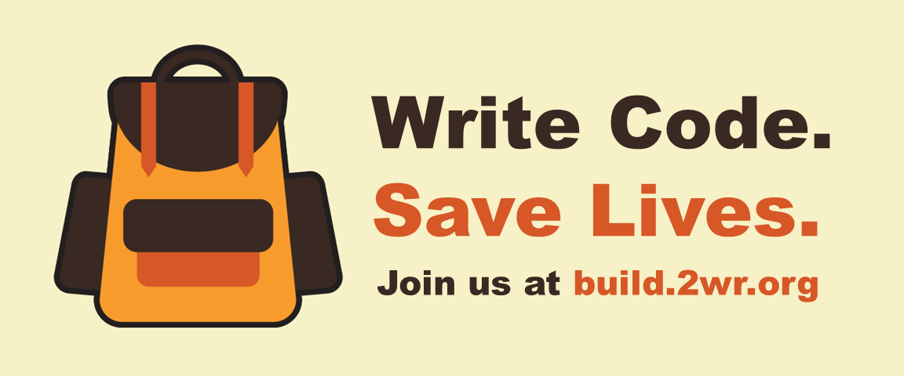
Demo
Notes:
Quick intro to the Two Weeks Ready
Setup and Code Gen Show package.json npx playwright install
npx playwright codegen
Running tests npx playwright test npx playwright test hazard-info.spec.js
npx playwright test hazard-info.spec.js –headed npx playwright test hazard-info.spec.js --headed --browser=firefox
npx playwright test hazard-info.spec.js --headed --browser=all
Debugging / Tracing
npx playwright test hazard-info.spec.js –debug
Make a breaking change
Welcome component
<p :style="{ color: '#BBBBBB' }">
Hazard Info Component
<v-btn x-large color="primary" width="80%" @click="beforeDialog = false">Before</v-btn>
npx playwright test hazard-info.spec.js –trace=on
npx playwright show-trace .\test-results\tests-hazard-info-Navigate-to-Hazard-Info-shows-Earthquake-Harzard-info\trace.zip
Screenshots / Recordings use: {
baseURL: "http://localhost:8080/",
screenshot: "only-on-failure",
recording: "retain-on-failure",
trace: "retain-on-failure",
// Tell all tests to load signed-in state from 'storageState.json'.
storageState: "./tests/_storagestate/storageState.json"
}
Reporters
npx playwright test –reporter=html
Review Auth Scenarios in Global Setup

Slide 11

Build Pipeline Integration
Notes:
Check in breaking changes from previous demo Show GitHub Actions workflow for app
Show how traces, reports, screenshots are uploaded

Slide 12




Isolation Strategies
But what about the backend?

Slide 13

Page Object Model
https://playwright.dev/docs/pom

Slide 14
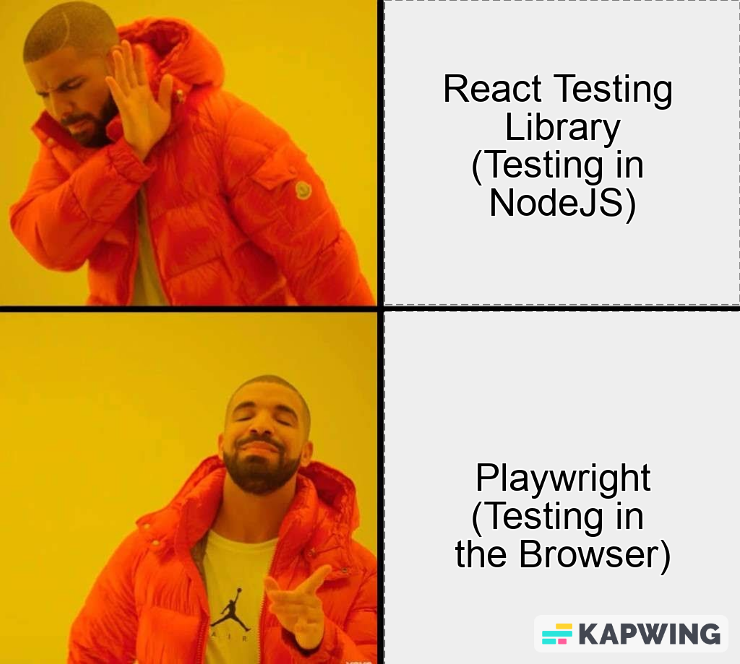
Component Testing

Slide 15
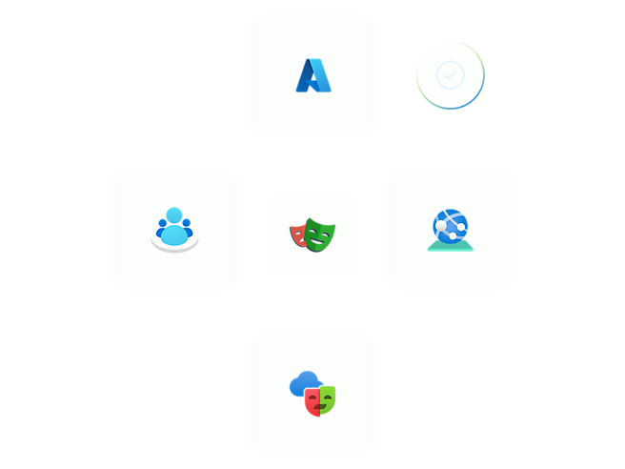
Microsoft Playwright Testing Service

Slide 16




Happy testing
@Dave_Paquette
https://www.aspnetmonsters.com https://www.davepaquette.com

